Slide 1

Product Clustering: Grouping for Insights
Product clustering groups similar products together. The grouping is based on shared attributes. This enhances marketing efforts and personalizes recommendations. It also optimizes inventory.

Slide 2

Why Cluster Products? The Business Value
1
Enhanced Segmentation
2
Personalized Recommendations
Tailor marketing to specific product groups. Expect a 20% increase in click-through rates.
Suggest relevant products based on cluster affinity. This may lead to a 10-15% sales uplift.
3
Optimized Inventory
Predict demand and streamline supply chains. Inventory costs could be reduced by 5-10%.

Slide 3
Key Attributes for Product Clustering
RETAIL SALES
WAREHOUSE SALES
TOTAL SALES
RETAIL TRANSFERS
Shows consumer demand for a product at retail stores.
SUM OF BOTH RETAIL AND WAREHOUSE SALES
Shows how much product is sold in bulk to retailers from the warehouse.
Indicates how often products are moved between retail locations to balance stock levels.
Helps distinguish fast-moving from slow-moving products.
Helps in identifying distribution-heavy vs. direct-to-consumer products.
High transfers may suggest supply chain issues or uneven demand.

Slide 4

Popular Clustering Algorithms for Products
K-Means
DBSCAN
Agglomerative
Partition products into K clusters. It's simple and fast, but requires pre-defined K.
Identify clusters based on density. It's robust to outliers, but parameter sensitive.
It uses a bottom-up approach. It starts with each object forming its own cluster and then iteratively merges the clusters according to their similarity to form large clusters.
Gaussian Mixture
OPTICS
BIRCH
A Gaussian mixture model is a soft clustering technique used in unsupervised learning to determine the probability that a given data point belongs to a cluster. It’s composed of several Gaussians, each identified by k ∈ {1,…, K}, where K is the number of clusters in a data set and is comprised of the following parameters.
OPTICS (Ordering Points To Identify the Clustering Structure) is a density-based clustering algorithm similar to DBSCAN clustering. Unlike DBSCAN which struggles with varying densities OPTICS can detect clusters of different densities and hierarchical structures. This makes it highly effective for large, complex datasets and in this article we learn more about its working and its implementation in python.
Balanced Iterative Reducing and Clustering using Hierarchies (BIRCH) is a clustering algorithm that can cluster large datasets by first generating a small and compact summary of the large dataset that retains as much information as possible. This smaller summary is then clustered instead of clustering the larger dataset. BIRCH is often used to complement other clustering algorithms by creating a summary of the dataset that the other clustering algorithm can now use.

Slide 5
FEATURE ENGINEERING
1
Aggregating Sales
2
Sales Ratio
This groups the dataset by ITEM CODE and sums the sales-related columns.
Retail to Warehouse Ratio:
Measures how much of an item's sales come from retail compared to warehouse sales.
Helps analyze total sales per item rather than per transaction.
Reduces data size and removes unnecessary transaction-level granularity.
A higher ratio means more direct retail sales, whereas a lower ratio suggests warehouse sales dominate.
Retail Transfer Ratio:
Measures how much of the retail sales are transferred rather than sold directly.
Helps identify items frequently moving between locations before being sold.
3
Total Sales Calculation
4
Moving Average Sales
Captures the overall demand for each item by summing all types of sales.
Accounts for sales trends over time by computing a moving average with a window of 3.
A key indicator of an item's popularity.
Helps smooth out fluctuations and detect consistent demand patterns.
Reduces noise in sales data by considering recent sales behavior.

Slide 6




Real-World Applications: Examples
E-commerce
Amazon's product recommendations increase sales by 30%.
Retail
Target's personalized promotions boost loyalty by 25%.
Manufacturing
GE's predictive maintenance reduces downtime by 15%.

Slide 7



Evaluating Cluster Quality: Metrics to Consider
Davies-Bouldin Index
2
Assess the average similarity between clusters.
Silhouette Score
1
Measure the separation between clusters.
Calinski-Harabasz Index
3
Evaluate variance ratio.

Slide 8
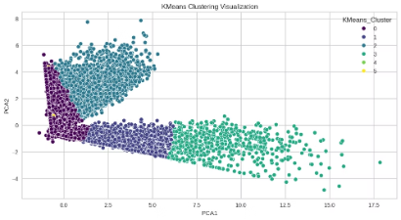
EXPLORATORY DATA ANALYIS OF THE MODEL
K-MEANS CLUSTERING
Cluster 0 (Dark Purple - Bottom Left)
Represents low sales and low transfer products.
These could be slow-moving products or those with stable but low demand.
The density suggests many products belong to this category.
Cluster 1 (Blue - Middle Left to Upper Right)
Represents products with moderate-to-high sales.
These products might be seasonal or location-dependent.
The spread of points suggests variability in demand.
Cluster 2 (Teal - Top Right)
Represents products with high sales and high retail transfers.
Could be fast-moving products or those needing frequent stock adjustments.
Indicates high consumer demand with significant inventory movement.
Cluster 3 (Green - Middle Right)
Represents products with steady but slightly fluctuating sales.
Possibly mid-range products in terms of sales volume.
Cluster 4 (Light Green - Rightmost)
Represents products with high warehouse sales but possibly lower retail sales.
Could be bulk warehouse products or wholesale-driven items.
Cluster 5 (Yellow - Single Point)
Likely represents an outlier.
Could be a rare product, a special promotion, or an error in the data.

Slide 9
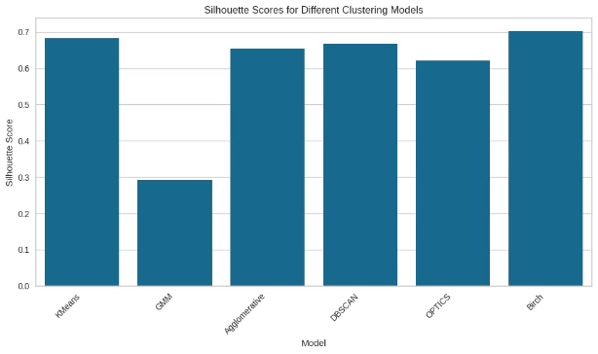
Silhouette scores of different models
✅ BIRCH has the highest Silhouette Score (~0.70)
This suggests that BIRCH provides the most well-separated clusters for this dataset.
BIRCH is efficient for large datasets with noise and hierarchical properties.
✅ K-Means, Agglomerative, and DBSCAN also perform well (~0.65 - 0.68)
K-Means is a strong choice if clusters are spherical and well-separated.
DBSCAN is useful if density variations exist, as it can detect outliers.
Agglomerative clustering is suitable for hierarchical relationships.
✅ GMM performs the worst (~0.32)
This suggests that the data does not fit well into Gaussian distributions.
GMM assumes clusters have an elliptical shape, which may not be the case here.

Slide 10
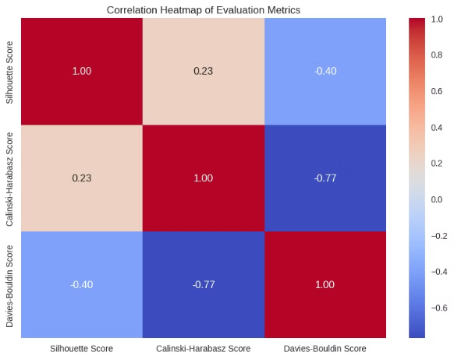
Correlation Map of different Metrics
✅ Silhouette Score vs. Davies-Bouldin Score (-0.40)
A moderate negative correlation suggests that when clusters are well-separated (higher Silhouette Score), the Davies-Bouldin Score (which measures cluster compactness and separation) tends to improve (decrease).
✅ Calinski-Harabasz Score vs. Davies-Bouldin Score (-0.77)
A strong negative correlation suggests that a high Calinski-Harabasz Score (which favors dense, well-separated clusters) is highly associated with a low Davies-Bouldin Score (which is desirable).
This means both scores agree well on evaluating clustering quality.
✅ Silhouette Score vs. Calinski-Harabasz Score (0.23)
A weak correlation suggests these two scores capture slightly different clustering aspects.
Silhouette Score measures how similar points are within clusters, while Calinski-Harabasz focuses on the separation between clusters.

Slide 11
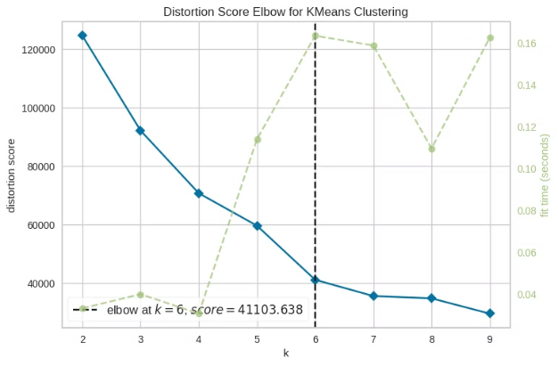
ELBOW FOR K-MEANS
✅ Elbow at k = 6 (Optimal Number of Clusters)
The distortion score decreases rapidly until k=6, then the rate of decrease slows down.
This suggests that after k=6, additional clusters do not provide significant improvement in compactness.
✅ Distortion Score Behavior
A steep decline from k=2 to k=6 shows that increasing clusters improves clustering quality.
After k=6, the curve flattens, meaning adding more clusters does not significantly reduce intra-cluster variance.
✅ Fit Time (Green Line) Consideration
Computation time increases as k increases, peaking around k=6.
This indicates that k=6 may be a practical choice since higher k values provide diminishing returns while increasing computational cost.

Slide 12
Clustering Algorithm Evaluation Metrics
Comparison of Silhouette Score, Calinski-Harabasz Score, and Davies-Bouldin Score for various clustering algorithms.
Algorithm
Silhouette Score
Calinski-Harabasz Score
Davies-Bouldin Score
KMeans
0.682187
15093.347361
0.607579
GMM
0.292693
4966.830579
1.347039
Agglomerative
0.654231
17239.714347
0.683723
DBSCAN
0.667800
715.930215
1.710842
OPTICS
0.621686
64.145959
1.343805
Birch
0.702409
7410.423515
0.440370
Silhouette Score: Measures how similar an object is to its own cluster compared to other clusters. Higher values indicate better-defined clusters.
Calinski-Harabasz Score: Also known as the Variance Ratio Criterion, measures the ratio of between-cluster variance to within-cluster variance. Higher values indicate better-defined clusters.
Davies-Bouldin Score: Measures the average similarity ratio of each cluster with its most similar cluster. Lower values indicate better clustering.

Slide 13




Best Practices for Effective Product Clustering
Data Preprocessing
Feature Selection
Algorithm Selection
Clean and normalize data. Improve accuracy by 15-20%.
Identify relevant attributes. Reduce noise and improve performance.
Choose based on data and objectives.

Slide 14

Conclusion: Unlocking Value with Product Clustering
Product clustering provides deeper insights into product portfolios. Companies can improve marketing and personalize experiences. They can also optimize inventory and drive revenue growth.
Embrace product clustering to unlock opportunities. Stay ahead in today's competitive landscape.

